Slide 1
NT219- Cryptography
WEEK 3: Modern Symmetric Ciphers
PhD. Ngoc-Tu Nguyen
tunn@uit.edu.vn

Slide 2
Outline
Stream Cipher
Block cipher
Data Encryption Standard (DES)
Advanced Encryption Standard (AES)
Some other ciphers
Searchable encryption
Homomorphic encryption
Attribute based encryption
Notes:
Cipher=a secret system of writing;

Slide 3


Textbooks and References
Text books
[1] Chapter 4,6
[2] Chapter 5

Slide 4
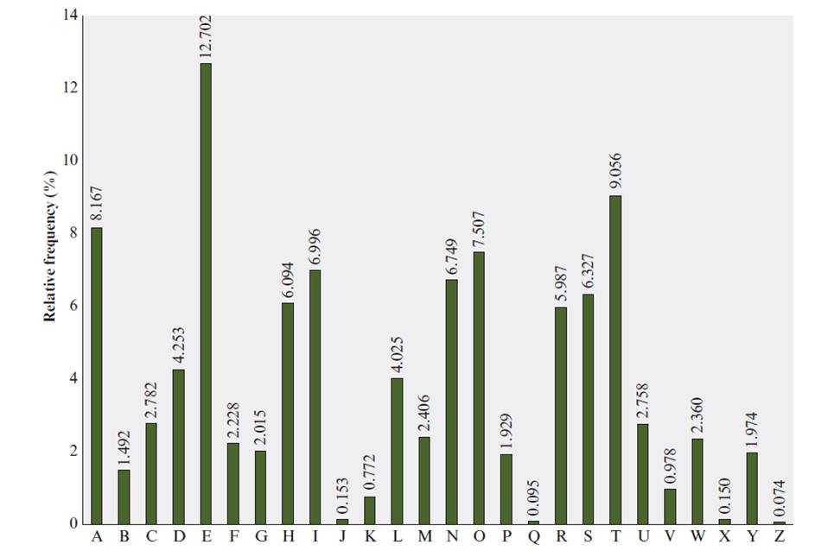
Classical symmetric cipher cryptanalysis
Notes:
There is, however, another line of attack. If the cryptanalyst knows the nature
of the plaintext (e.g., noncompressed English text), then the analyst can exploit the
regularities of the language. To see how such a cryptanalysis might proceed, we give
a partial example here that is adapted from one in [SINK09]. The ciphertext to be
solved is
UZQSOVUOHXMOPVGPOZPEVSGZWSZOPFPESXUDBMETSXAIZ
VUEPHZHMDZSHZOWSFPAPPDTSVPQUZWYMXUZUHSX
EPYEPOPDZSZUFPOMBZWPFUPZHMDJUDTMOHMQ
As a first step, the relative frequency of the letters can be determined and
compared to a standard frequency distribution for English, such as is shown in
Figure 3.5 (based on [LEWA00]). If the message were long enough, this technique
alone might be sufficient, but because this is a relatively short message, we cannot
expect an exact match. In any case, the relative frequencies of the letters in the
ciphertext (in percentages) are as follows:
P 13.33 H 5.83 F 3.33 B 1.67 C 0.00
Z 11.67 D 5.00 W 3.33 G 1.67 K 0.00
S 8.33 E 5.00 Q 2.50 Y 1.67 L 0.00
U 8.33 V 4.17 T 2.50 I 0.83 N 0.00
O 7.50 X 4.17 A 1.67 J 0.83 R 0.00
M 6.67
Comparing this breakdown with Figure 3.5, it seems likely that cipher letters P
and Z are the equivalents of plain letters e and t, but it is not certain which is which.
The letters S, U, O, M, and H are all of relatively high frequency and probably correspond
to plain letters from the set {a, h, i, n, o, r, s}. The letters with the lowest
frequencies (namely, A, B, G, Y, I, J) are likely included in the set {b, j, k, q, v, x, z}.
There are a number of ways to proceed at this point. We could make some tentative
assignments and start to fill in the plaintext to see if it looks like a reasonable
“skeleton” of a message. A more systematic approach is to look for other regularities.
For example, certain words may be known to be in the text. Or we could look for
repeating sequences of cipher letters and try to deduce their plaintext equivalents.

Slide 5
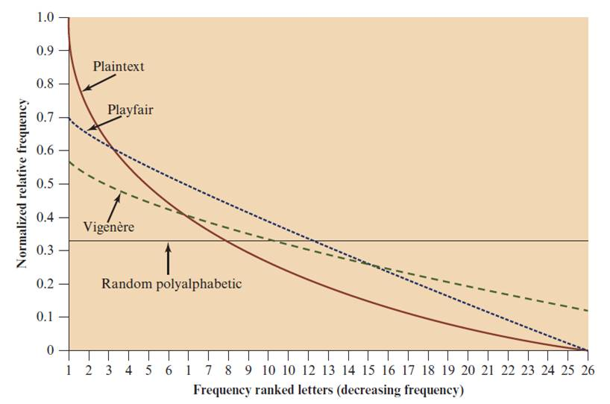
Classical symmetric cipher cryptanalysis
Notes:
One way of revealing the effectiveness of the Playfair and other ciphers
is shown in Figure 3.6. The line labeled plaintext plots a typical frequency
distribution of the 26 alphabetic characters (no distinction between upper
and lower case) in ordinary text. This is also the frequency distribution of any
monoalphabetic substitution cipher, because the frequency values for individual
letters are the same, just with different letters substituted for the original letters.
The plot is developed in the following way: The number of occurrences of each
letter in the text is counted and divided by the number of occurrences of the
most frequently used letter. Using the results of Figure 3.5, we see that
e is the most frequently used letter. As a result, e has a relative frequency of 1, t of
9.056/12.702 0.72, and so on. The points on the horizontal axis correspond
to the letters in order of decreasing frequency.
Figure 3.6 also shows the frequency distribution that results when the text
is encrypted using the Playfair cipher. To normalize the plot, the number of
occurrences of each letter in the ciphertext was again divided by the number of
occurrences of e in the plaintext. The resulting plot therefore shows the extent
to which the frequency distribution of letters, which makes it trivial to solve
substitution ciphers, is masked by encryption. If the frequency distribution
information were totally concealed in the encryption process, the ciphertext plot
of frequencies would be flat, and cryptanalysis using ciphertext only would be
effectively impossible. As the figure shows, the Playfair cipher has a flatter distribution
than does plaintext, but nevertheless, it reveals plenty of structure for
a cryptanalyst to work with. The plot also shows the Vigenère cipher, discussed
subsequently. The Hill and Vigenère curves on the plot are based on results
reported in [SIMM93].

Slide 6



Stream Cipher (1 of 10)
Secret key (Keystream)
Plaintext stream
bit or byte
Ciphertext
where
Notes:
A stream cipher is one that encrypts a digital data stream one bit or one byte at
a time. Examples of classical stream ciphers are the autokeyed Vigenère cipher
and the Vernam cipher. In the ideal case, a one-time pad version of the Vernam
cipher would be used (Figure 3.7), in which the keystream (k_{i} ) is as long as the
plaintext bit stream (p_{i} ). If the cryptographic keystream is random, then this cipher
is unbreakable by any means other than acquiring the keystream. However, the
keystream must be provided to both users in advance via some independent and
secure channel. This introduces insurmountable logistical problems if the intended
data traffic is very large.
Accordingly, for practical reasons, the bit-stream generator must be
implemented as an algorithmic procedure, so that the cryptographic bit stream
can be produced by both users. In this approach (Figure 4.1a), the bit-stream
generator is a key-controlled algorithm and must produce a bit stream that is
cryptographically strong. That is, it must be computationally impractical to
predict future portions of the bit stream based on previous portions of the bit
stream. The two users need only share the generating key, and each can produce
the keystream.

Slide 7
Stream Cipher (2 of 10)
Encrypts a digital data stream one bit or one byte at a time
Examples:
Autokeyed Vigenère cipher
Vernam cipher
In the ideal case, a one-time pad version of the Vernam cipher would be used, in which the keystream is as long as the plaintext bit stream
If the cryptographic keystream is random, then this cipher is unbreakable by any means other than acquiring the keystream
Keystream must be provided to both users in advance via some independent and secure channel
This introduces insurmountable logistical problems if the intended data traffic is very large
Notes:
A stream cipher is one that encrypts a digital data stream one bit or one byte at
a time. Examples of classical stream ciphers are the autokeyed Vigenère cipher
and the Vernam cipher. In the ideal case, a one-time pad version of the Vernam
cipher would be used (Figure 3.7), in which the keystream (k_{i} ) is as long as the
plaintext bit stream (p_{i} ). If the cryptographic keystream is random, then this cipher
is unbreakable by any means other than acquiring the keystream. However, the
keystream must be provided to both users in advance via some independent and
secure channel. This introduces insurmountable logistical problems if the intended
data traffic is very large.
Accordingly, for practical reasons, the bit-stream generator must be
implemented as an algorithmic procedure, so that the cryptographic bit stream
can be produced by both users. In this approach (Figure 4.1a), the bit-stream
generator is a key-controlled algorithm and must produce a bit stream that is
cryptographically strong. That is, it must be computationally impractical to
predict future portions of the bit stream based on previous portions of the bit
stream. The two users need only share the generating key, and each can produce
the keystream.

Slide 8
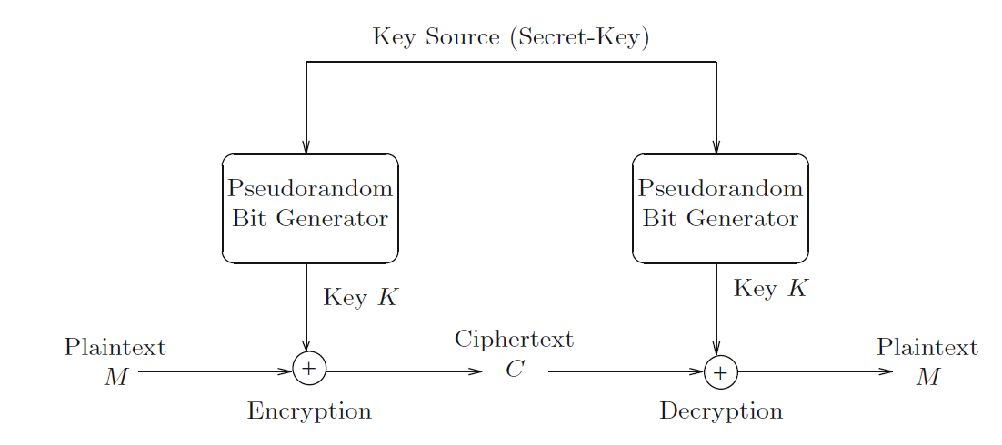
Stream Cipher (3 of 10)

Slide 9
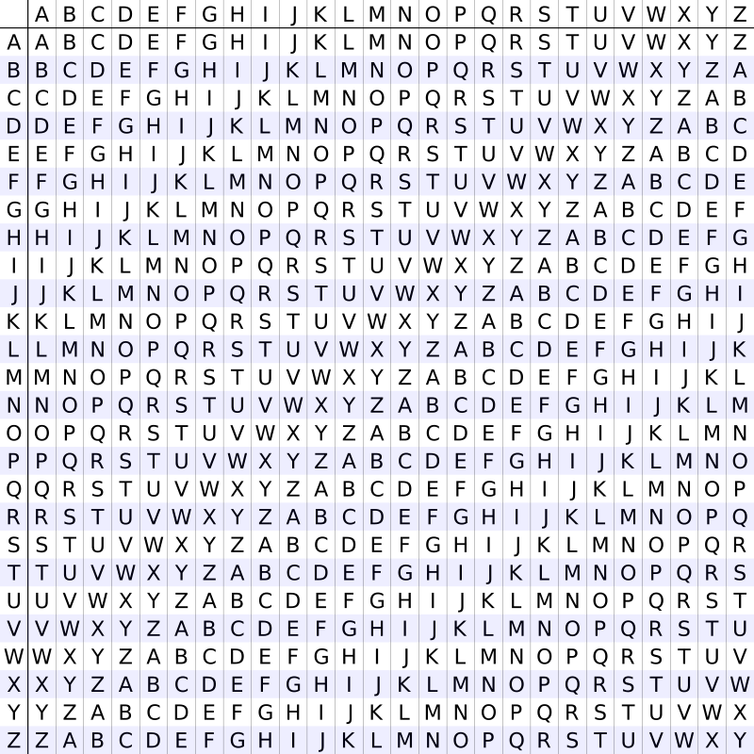
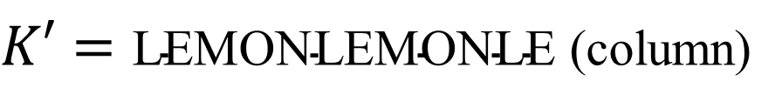

Stream Cipher (4 of 10)
AYUSH
Vigenère cipher
Plaintext stream
M= ATTACKATDAWN (row)
Keystream
$K′=\text{LEMONLEMONLE}$ (column)
Ciphertext
$$C=\text{LXFOPVEFRNHR}$$
Notes:
A stream cipher is one that encrypts a digital data stream one bit or one byte at
a time. Examples of classical stream ciphers are the autokeyed Vigenère cipher
and the Vernam cipher. In the ideal case, a one-time pad version of the Vernam
cipher would be used (Figure 3.7), in which the keystream (k_{i} ) is as long as the
plaintext bit stream (p_{i} ). If the cryptographic keystream is random, then this cipher
is unbreakable by any means other than acquiring the keystream. However, the
keystream must be provided to both users in advance via some independent and
secure channel. This introduces insurmountable logistical problems if the intended
data traffic is very large.
Accordingly, for practical reasons, the bit-stream generator must be
implemented as an algorithmic procedure, so that the cryptographic bit stream
can be produced by both users. In this approach (Figure 4.1a), the bit-stream
generator is a key-controlled algorithm and must produce a bit stream that is
cryptographically strong. That is, it must be computationally impractical to
predict future portions of the bit stream based on previous portions of the bit
stream. The two users need only share the generating key, and each can produce
the keystream.

Slide 10



Stream Cipher (5 of 10)
Vigenère cipher
Plaintext stream
Secret key (Keystream)
Ciphertext
where
Notes:
A stream cipher is one that encrypts a digital data stream one bit or one byte at
a time. Examples of classical stream ciphers are the autokeyed Vigenère cipher
and the Vernam cipher. In the ideal case, a one-time pad version of the Vernam
cipher would be used (Figure 3.7), in which the keystream (k_{i} ) is as long as the
plaintext bit stream (p_{i} ). If the cryptographic keystream is random, then this cipher
is unbreakable by any means other than acquiring the keystream. However, the
keystream must be provided to both users in advance via some independent and
secure channel. This introduces insurmountable logistical problems if the intended
data traffic is very large.
Accordingly, for practical reasons, the bit-stream generator must be
implemented as an algorithmic procedure, so that the cryptographic bit stream
can be produced by both users. In this approach (Figure 4.1a), the bit-stream
generator is a key-controlled algorithm and must produce a bit stream that is
cryptographically strong. That is, it must be computationally impractical to
predict future portions of the bit stream based on previous portions of the bit
stream. The two users need only share the generating key, and each can produce
the keystream.

Slide 11
Stream Cipher (6 of 10)
For practical: must be implemented as an algorithmic to generate key bit stream (both users)
It must be computationally impractical to predict future portions of the bit stream based on previous portions of the bit stream
The two users need only share the generating key and each can produce the keystream

Slide 12
Stream Cipher (7 of 10)

Slide 13
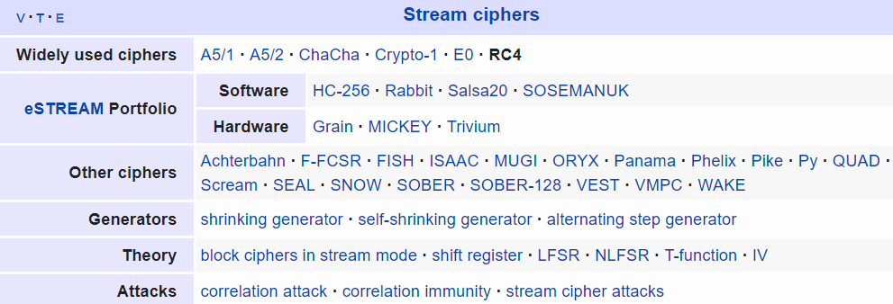
Stream Cipher (8 of 10)
Rivest Cipher 4
https://en.wikipedia.org/wiki/RC4
Chaotic-based cryptosystem
https://en.wikipedia.org/wiki/List_of_chaotic_maps

Slide 14
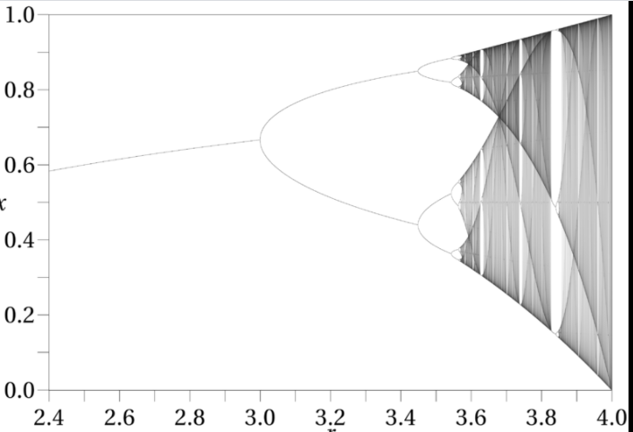

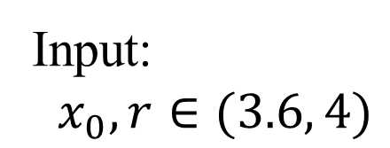

Stream Cipher (9 of 10)
Chaotic-based cryptosystem
Example:
Logistic map
Input:
$x_{0}, r∈(3.6, 4)$
Output:
$${ x}_{1},x_{2},x_{3},…x_{n},….$$
$$0<x_{i}<1$$

Slide 15

Stream Cipher (10 of 10)
Chaotic-based crypto system
Chaotic maps
Image$,$ Video

Slide 16
Outline
Stream Cipher
Block cipher
Data Encryption Standard (DES)
Advanced Encryption Standard (AES)
Some other ciphers
Searchable encryption
Homomorphic encryption
Attribute based encryption
Notes:
Cipher=a secret system of writing;

Slide 17
Block Cipher
A block of plaintext is treated as a whole and used to produce a ciphertext block of equal length
Typically a block size of 64 or 128 bits is used
As with a stream cipher, the two users share a symmetric encryption key
The majority of network-based symmetric cryptographic applications make use of block ciphers
Notes:
A block cipher is one in which a block of plaintext is treated as a whole
and used to produce a ciphertext block of equal length. Typically, a block size of
64 or 128 bits is used. As with a stream cipher, the two users share a symmetric
encryption key (Figure 4.1b). Using some of the modes of operation explained
in Chapter 7, a block cipher can be used to achieve the same effect as a stream
cipher.
Far more effort has gone into analyzing block ciphers. In general, they seem
applicable to a broader range of applications than stream ciphers. The vast majority
of network-based symmetric cryptographic applications make use of block
ciphers. Accordingly, the concern in this chapter, and in our discussions throughout
the book of symmetric encryption, will primarily focus on block ciphers.

Slide 18
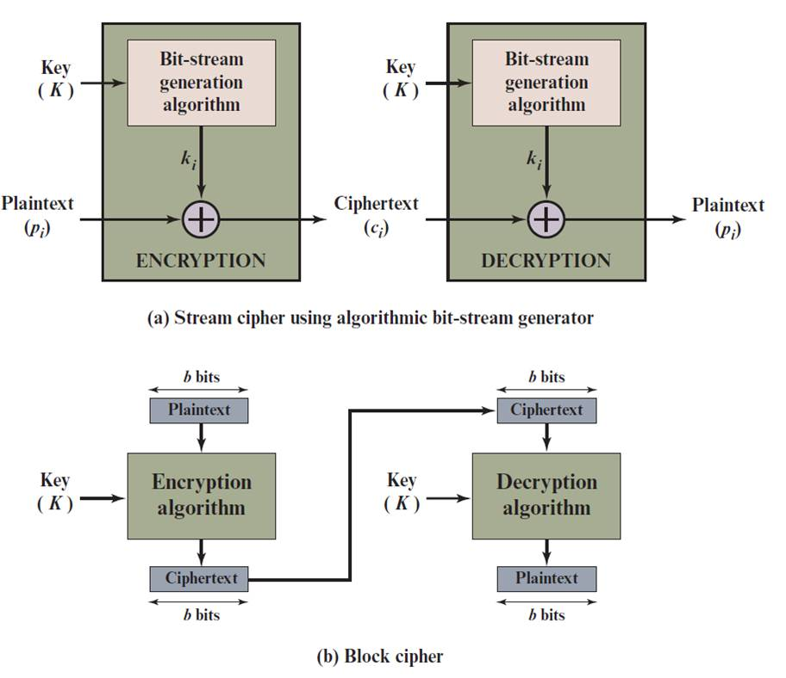
Stream Cipher Vs. Block Cipher
Notes:
Examples of stream and block ciphers.

Slide 19

Encryption and Decryption Tables for Substitution Cipher
$$b_{1}b_{2}b_{3}b_{4}$$
Plaintext | Ciphertext
0000 | 1110
0001 | 0100
0010 | 1101
0011 | 0001
0100 | 0010
0101 | 1111
0110 | 1011
0111 | 1000
1000 | 0011
1001 | 1010
1010 | 0110
1011 | 1100
1100 | 0101
1101 | 1001
1110 | 0000
1111 | 0111
Ciphertext | Plaintext
0000 | 1110
0001 | 0011
0010 | 0100
0011 | 1000
0100 | 0001
0101 | 1100
0110 | 1010
0111 | 1111
1000 | 0111
1001 | 1101
1010 | 1001
1011 | 0110
1100 | 1011
1101 | 0010
1110 | 0000
1111 | 0101
Notes:
The encryption and decryption mappings can be defined
by a tabulation, as shown in Table 4.1. This is the most general form of block cipher
and can be used to define any reversible mapping between plaintext and ciphertext.
Feistel refers to this as the ideal block cipher, because it allows for the maximum
number of possible encryption mappings from the plaintext block [FEIS75].

Slide 20
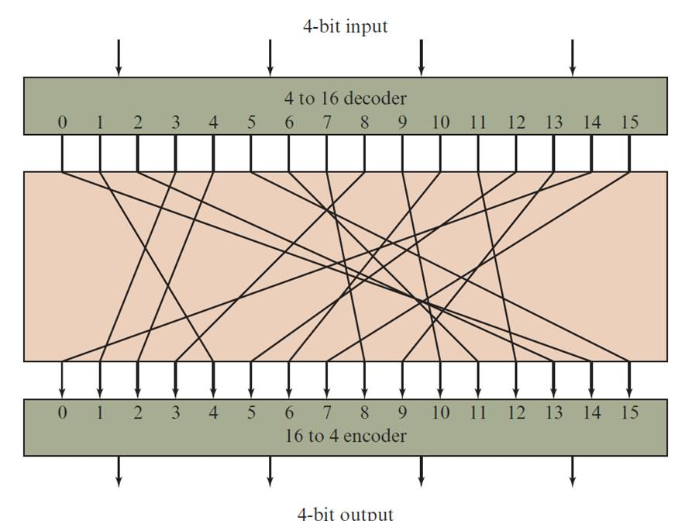


Block Substitution
$$b_{1}b_{2}b_{3}b_{4}$$
4-bits block substitution
0000
$$c_{1}c_{2}c_{3}c_{4}$$
1111
Notes:
A block cipher operates on a plaintext block of n bits to produce a ciphertext
block of n bits. There are 2^{n} possible different plaintext blocks and, for the
encryption to be reversible (i.e., for decryption to be possible), each must produce
a unique ciphertext block. Such a transformation is called reversible, or nonsingular.
Figure 4.2 illustrates the logic of a general substitution cipher for n = 4.
A 4-bit input produces one of 16 possible input states, which is mapped by the substitution
cipher into a unique one of 16 possible output states, each of which is represented
by 4 ciphertext bits.

Slide 21


Block Substitution
How many possible substitutions for a block n-bit?
$$b_{1}b_{2}b_{3}….b_{n}$$
$$c_{1}c_{2}c_{3}….c_{n}$$

Slide 22
Feistel Cipher
Feistel proposed the use of a cipher that alternates substitutions and permutations
Substitutions
Each plaintext element or group of elements is uniquely replaced by a corresponding ciphertext element or group of elements
Permutation
No elements are added or deleted or replaced in the sequence, rather the order in which the elements appear in the sequence is changed
Is a practical application of a proposal by Claude Shannon to develop a product cipher that alternates confusion and diffusion functions
Is the structure used by many significant symmetric block ciphers currently in use
Feistel, H. (1973). Cryptography and computer privacy. Scientific american, 228(5), 15-23.
Notes:
Feistel proposed [FEIS73] that we can approximate the ideal block cipher by utilizing
the concept of a product cipher, which is the execution of two or more simple ciphers
in sequence in such a way that the final result or product is cryptographically stronger
than any of the component ciphers. The essence of the approach is to develop a block
cipher with a key length of k bits and a block length of n bits, allowing a total of 2^{k}
possible transformations, rather than the 2^{n} ! transformations available with the ideal
block cipher.
In particular, Feistel proposed the use of a cipher that alternates substitutions
and permutations, where these terms are defined as follows:
• Substitution: Each plaintext element or group of elements is uniquely replaced
by a corresponding ciphertext element or group of elements.
• Permutation: A sequence of plaintext elements is replaced by a permutation
of that sequence. That is, no elements are added or deleted or replaced in the
sequence, rather the order in which the elements appear in the sequence is
changed.
In fact, Feistel’s is a practical application of a proposal by Claude Shannon
to develop a product cipher that alternates confusion and diffusion functions
[SHAN49]. We look next at these concepts of diffusion and confusion and then
present the Feistel cipher. But first, it is worth commenting on this remarkable fact:
The Feistel cipher structure, which dates back over a quarter century and which, in
turn, is based on Shannon’s proposal of 1945, is the structure used by many significant
symmetric block ciphers currently in use.
In particular, the Feistel structure
is used for Triple Data Encryption Algorithm (TDEA), which is one of the two
encryption algorithms (along with AES), approved for general use by the National
Institute of Standards and Technology (NIST). The Feistel structure is also used for
several schemes for format-preserving encryption, which have recently come into
prominence. In addition, the Camellia block cipher is a Feistel structure; it is one
of the possible symmetric ciphers in TLS and a number of other Internet security
protocols. Both TDEA and format-preserving encryption are covered in Chapter 7.

Slide 23
Diffusion and Confusion
Terms introduced by Claude Shannon to capture the two basic building blocks for any cryptographic system
Shannon’s concern was to thwart cryptanalysis based on statistical analysis
Diffusion
The statistical structure of the plaintext is dissipated into long-range statistics of the ciphertext
This is achieved by having each plaintext digit affect the value of many ciphertext digits
Confusion
Seeks to make the relationship between the statistics of the ciphertext and the value of the encryption key as complex as possible
Even if the attacker can get some handle on the statistics of the ciphertext, the way in which the key was used to produce that ciphertext is so complex as to make it difficult to deduce the key
Notes:
The terms diffusion and confusion were introduced by
Claude Shannon to capture the two basic building blocks for any cryptographic
system [SHAN49]. Shannon’s concern was to thwart cryptanalysis based on statistical
analysis. The reasoning is as follows. Assume the attacker has some knowledge
of the statistical characteristics of the plaintext. For example, in a human-readable
message in some language, the frequency distribution of the various letters may be
known. Or there may be words or phrases likely to appear in the message (probable
words). If these statistics are in any way reflected in the ciphertext, the cryptanalyst
may be able to deduce the encryption key, part of the key, or at least a set of keys
likely to contain the exact key. In what Shannon refers to as a strongly ideal cipher,
all statistics of the ciphertext are independent of the particular key used. The arbitrary
substitution cipher that we discussed previously (Figure 4.2) is such a cipher,
but as we have seen, it is impractical.
Other than recourse to ideal systems, Shannon suggests two methods for
frustrating statistical cryptanalysis: diffusion and confusion. In diffusion, the
statistical structure of the plaintext is dissipated into long-range statistics of the
ciphertext. This is achieved by having each plaintext digit affect the value of many
ciphertext digits; generally, this is equivalent to having each ciphertext digit be
affected by many plaintext digits.
Every block cipher involves a transformation of a block of plaintext into a
block of ciphertext, where the transformation depends on the key. The mechanism
of diffusion seeks to make the statistical relationship between the plaintext and
ciphertext as complex as possible in order to thwart attempts to deduce the key. On
the other hand, confusion seeks to make the relationship between the statistics of
the ciphertext and the value of the encryption key as complex as possible, again to
thwart attempts to discover the key. Thus, even if the attacker can get some handle
on the statistics of the ciphertext, the way in which the key was used to produce that
ciphertext is so complex as to make it difficult to deduce the key. This is achieved by
the use of a complex substitution algorithm. In contrast, a simple linear substitution
function would add little confusion.
As [ROBS95b] points out, so successful are diffusion and confusion in capturing
the essence of the desired attributes of a block cipher that they have become the
cornerstone of modern block cipher design.

Slide 24
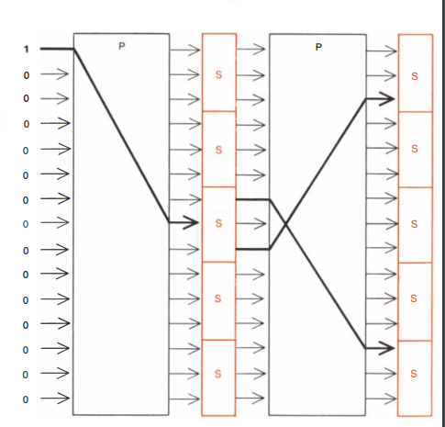
Diffusion and Confusion
Notes:
The left-hand side of Figure 4.3 depicts the structure
proposed by Feistel. The inputs to the encryption algorithm are a plaintext block of
length 2w bits and a key K . The plaintext block is divided into two halves, LE₀ and RE₀ .
The two halves of the data pass through n rounds of processing and then combine to
produce the ciphertext block. Each round i has as inputs LE_{i-1} and RE_{i-1} derived from
the previous round, as well as a subkey K_{i} derived from the overall K . In general,
the subkeys K_{i} are different from K and from each other. In Figure 4.3, 16 rounds
are used, although any number of rounds could be implemented.
All rounds have the same structure. A substitution is performed on the left half
of the data. This is done by applying a round function F to the right half of the data
and then taking the exclusive-OR of the output of that function and the left half of the
data. The round function has the same general structure for each round but is parameterized
by the round subkey K_{i} . Another way to express this is to say that F is a function
of right-half block of w bits and a subkey of y bits, which produces an output value
of length w bits: F (RE_{i} , K_{i+1} ). Following this substitution, a permutation is performed
that consists of the interchange of the two halves of the data. This structure is a particular
form of the substitution-permutation network (SPN) proposed by Shannon.

Slide 25
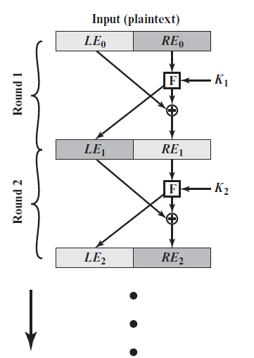
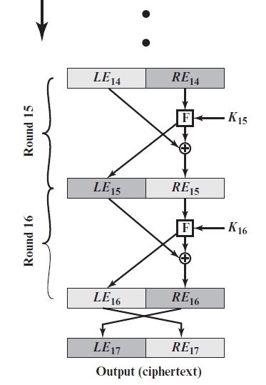
Feistel Encryption and Decryption (16 rounds)
P.126
Notes:
The left-hand side of Figure 4.3 depicts the structure
proposed by Feistel. The inputs to the encryption algorithm are a plaintext block of
length 2w bits and a key K . The plaintext block is divided into two halves, LE₀ and RE₀ .
The two halves of the data pass through n rounds of processing and then combine to
produce the ciphertext block. Each round i has as inputs LE_{i-1} and RE_{i-1} derived from
the previous round, as well as a subkey K_{i} derived from the overall K . In general,
the subkeys K_{i} are different from K and from each other. In Figure 4.3, 16 rounds
are used, although any number of rounds could be implemented.
All rounds have the same structure. A substitution is performed on the left half
of the data. This is done by applying a round function F to the right half of the data
and then taking the exclusive-OR of the output of that function and the left half of the
data. The round function has the same general structure for each round but is parameterized
by the round subkey K_{i} . Another way to express this is to say that F is a function
of right-half block of w bits and a subkey of y bits, which produces an output value
of length w bits: F (RE_{i} , K_{i+1} ). Following this substitution, a permutation is performed
that consists of the interchange of the two halves of the data. This structure is a particular
form of the substitution-permutation network (SPN) proposed by Shannon.

Slide 26
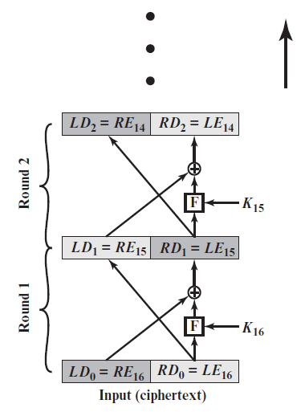
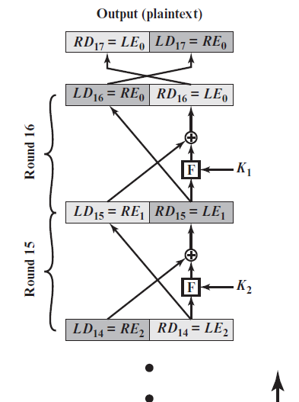
Feistel Encryption and Decryption (16 rounds)

Slide 27
The Feistel Cipher Scheme (FCS)
Divide M into blocks of 2l-bits long (pad the last block if needed)
Use only the XOR and Substitution operations
Generate n sub-keys of a fixed length from the encryption key K: K₁,…,K_{n}
Divide a 2l-bit block input into two parts: L₀ and R₀, both of size l (the suffix and prefix of the block, respectively)
Perform a substitution function F on an l-bit input string and a sub-key to produce an l-bit output
Encryption and decryption each executes n rounds of the same sequence of operations

Slide 28
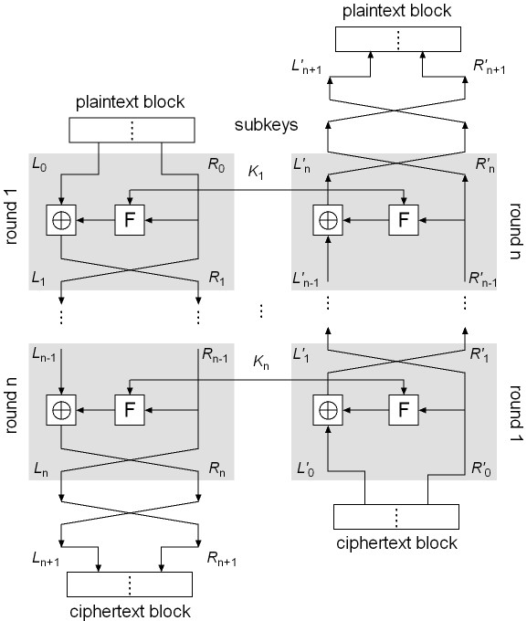
FCS Encryption and Decryption
FCS Encryption
Let M = L₀R₀; execute the following operations in round i, i = 1, …, n:
L_{i} = R_{i–1}
R_{i} = L_{i–1} ⊕ F(R_{i–1}, K_{i})
Let L_{n+1} = R_{n}, R_{n+1} = L_{n} and C = L_{n+1}R_{n+1}
FCS Decryption
Symmetrical to encryption, with sub-keys in reverse order
Rewrite C as C = L’₀R’₀
Execute the following in round i (i = 1, …, n):
L’_{i} = R’_{i–1}
R’_{i} = L’_{i–1} ⊕ F(R’_{i–1}, K’_{n–i+1})
Let L’_{n+1} = R’_{n}, R’_{n+1} = L’_{n}
We will show that M = L’_{n+1}R’_{n+1}
Encryption
Start
Decryption
Start

Slide 29
Proof of FCS decryption
Will show that C = L_{n+1}R_{n+1} = L’₀R’₀ is transformed back to M = L₀R₀ by the FCS Decryption algorithm
Prove by induction the following equalities:
(1) L’_{i} = R_{n–i} (2) R’_{i} = L_{n–i}
Basis: L₀’ = L_{n+1} = R_{n}, R₀’ = R_{n+1} = L_{n}; (1) and (2) hold
Hypothesis: Assume when i ≤ n:
L_{i–1}’ = R_{n–(i–1)} R_{i–1}’ = L_{n–(i–1)}
Induction step:
L’_{i} = R’_{i–1} (by decrypt. alg.) = L_{n–i+1} (by hypothesis) = R_{n–i} (by encrypt. alg.)
Hence (1) is true
R’_{i} = L’_{i–1} ⊕ F(R’_{i–1}, K_{n–i+1})
= R_{n–(i+1)} ⊕ F(L_{n–(i+1)}, K_{n–i+1})
= [L_{n–i} ⊕ F(R_{n–i}, K_{n–i+1})] ⊕ F(R_{n–i}, K_{n–i+1})
= L_{n–i}
Hence (2) true

Slide 30
Feistel Cipher Design Features (1 of 2)
Block size
Larger block sizes mean greater security but reduced encryption/decryption speed for a given algorithm
Key size
Larger key size means greater security but may decrease encryption/decryption speeds
Number of rounds
The essence of the Feistel cipher is that a single round offers inadequate security but that multiple rounds offer increasing security
Subkey generation algorithm
Greater complexity in this algorithm should lead to greater difficulty of cryptanalysis
Notes:
The exact realization of a Feistel network depends on the choice of the following
parameters and design features:
• Block size: Larger block sizes mean greater security (all other things being
equal) but reduced encryption/decryption speed for a given algorithm. The
greater security is achieved by greater diffusion. Traditionally, a block size of
64 bits has been considered a reasonable tradeoff and was nearly universal in
block cipher design. However, the new AES uses a 128-bit block size.
• Key size: Larger key size means greater security but may decrease encryption/
decryption speed. The greater security is achieved by greater resistance to
brute-force attacks and greater confusion. Key sizes of 64 bits or less are now
widely considered to be inadequate, and 128 bits has become a common size.
• Number of rounds: The essence of the Feistel cipher is that a single round
offers inadequate security but that multiple rounds offer increasing security.
A typical size is 16 rounds.
• Subkey generation algorithm: Greater complexity in this algorithm should
lead to greater difficulty of cryptanalysis.
• Round function F: Again, greater complexity generally means greater resistance
to cryptanalysis.
There are two other considerations in the design of a Feistel cipher:
• Fast software encryption/decryption: In many cases, encryption is embedded in
applications or utility functions in such a way as to preclude a hardware implementation.
Accordingly, the speed of execution of the algorithm becomes a
concern.
• Ease of analysis: Although we would like to make our algorithm as difficult as
possible to cryptanalyze, there is great benefit in making the algorithm easy to
analyze. That is, if the algorithm can be concisely and clearly explained, it is
easier to analyze that algorithm for cryptanalytic vulnerabilities and therefore
develop a higher level of assurance as to its strength. DES, for example, does
not have an easily analyzed functionality.

Slide 31
Feistel Cipher Design Features (2 of 2)
Round function F
Greater complexity generally means greater resistance to cryptanalysis
Fast software encryption/decryption
In many cases, encrypting is embedded in applications or utility functions in such a way as to preclude a hardware implementation; accordingly, the speed of execution of the algorithm becomes a concern
Ease of analysis
If the algorithm can be concisely and clearly explained, it is easier to analyze that algorithm for cryptanalytic vulnerabilities and therefore develop a higher level of assurance as to its strength
Notes:
The exact realization of a Feistel network depends on the choice of the following
parameters and design features:
• Block size: Larger block sizes mean greater security (all other things being
equal) but reduced encryption/decryption speed for a given algorithm. The
greater security is achieved by greater diffusion. Traditionally, a block size of
64 bits has been considered a reasonable tradeoff and was nearly universal in
block cipher design. However, the new AES uses a 128-bit block size.
• Key size: Larger key size means greater security but may decrease encryption/
decryption speed. The greater security is achieved by greater resistance to
brute-force attacks and greater confusion. Key sizes of 64 bits or less are now
widely considered to be inadequate, and 128 bits has become a common size.
• Number of rounds: The essence of the Feistel cipher is that a single round
offers inadequate security but that multiple rounds offer increasing security.
A typical size is 16 rounds.
• Subkey generation algorithm: Greater complexity in this algorithm should
lead to greater difficulty of cryptanalysis.
• Round function F: Again, greater complexity generally means greater resistance
to cryptanalysis.
There are two other considerations in the design of a Feistel cipher:
• Fast software encryption/decryption: In many cases, encryption is embedded in
applications or utility functions in such a way as to preclude a hardware implementation.
Accordingly, the speed of execution of the algorithm becomes a
concern.
• Ease of analysis: Although we would like to make our algorithm as difficult as
possible to cryptanalyze, there is great benefit in making the algorithm easy to
analyze. That is, if the algorithm can be concisely and clearly explained, it is
easier to analyze that algorithm for cryptanalytic vulnerabilities and therefore
develop a higher level of assurance as to its strength. DES, for example, does
not have an easily analyzed functionality.

Slide 32
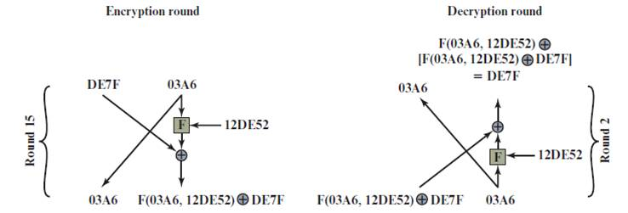
Feistel Example
Notes:
The process of decryption with a Feistel cipher
is essentially the same as the encryption process. The rule is as follows: Use the
ciphertext as input to the algorithm, but use the subkeys K_{i} in reverse order. That
is, use K_{n} in the first round, K_{n-1} in the second round, and so on, until K₁ is used in
the last round. This is a nice feature, because it means we need not implement two
different algorithms; one for encryption and one for decryption.

Slide 33
Outline
Stream Cipher
Block cipher
Data Encryption Standard (DES)
Advanced Encryption Standard (AES)
Some other ciphers
Searchable encryption
Homomorphic encryption
Attribute based encryption
Notes:
Cipher=a secret system of writing;

Slide 34
Data Encryption Standard (DES)
Issued in 1977 by the National Bureau of Standards (now NIST) as Federal Information Processing Standard 46
Was the most widely used encryption scheme until the introduction of the Advanced Encryption Standard (AES) in 2001
Algorithm itself is referred to as the Data Encryption Algorithm (DEA)
Data are encrypted in 64-bit blocks using a 56-bit key
The algorithm transforms 64-bit input in a series of steps into a 64-bit output
The same steps, with the same key, are used to reverse the encryption
Notes:
Until the introduction of the Advanced Encryption Standard (AES) in 2001, the
Data Encryption Standard (DES) was the most widely used encryption scheme.
DES was issued in 1977 by the National Bureau of Standards, now the National
Institute of Standards and Technology (NIST), as Federal Information Processing
Standard 46 (FIPS PUB 46). The algorithm itself is referred to as the Data
Encryption Algorithm (DEA). For DEA, data are encrypted in 64-bit blocks using
a 56-bit key. The algorithm transforms 64-bit input in a series of steps into a 64-bit
output. The same steps, with the same key, are used to reverse the encryption.
Over the years, DES became the dominant symmetric encryption algorithm,
especially in financial applications. In 1994, NIST reaffirmed DES for federal use
for another five years; NIST recommended the use of DES for applications other
than the protection of classified information. In 1999, NIST issued a new version
of its standard (FIPS PUB 46-3) that indicated that DES should be used only for
legacy systems and that triple DES (which in essence involves repeating the DES
algorithm three times on the plaintext using two or three different keys to produce
the ciphertext) be used. We study triple DES in Chapter 7. Because the underlying
encryption and decryption algorithms are the same for DES and triple DES, it
remains important to understand the DES cipher. This section provides an overview.
For the interested reader, Appendix C provides further detail.

Slide 35
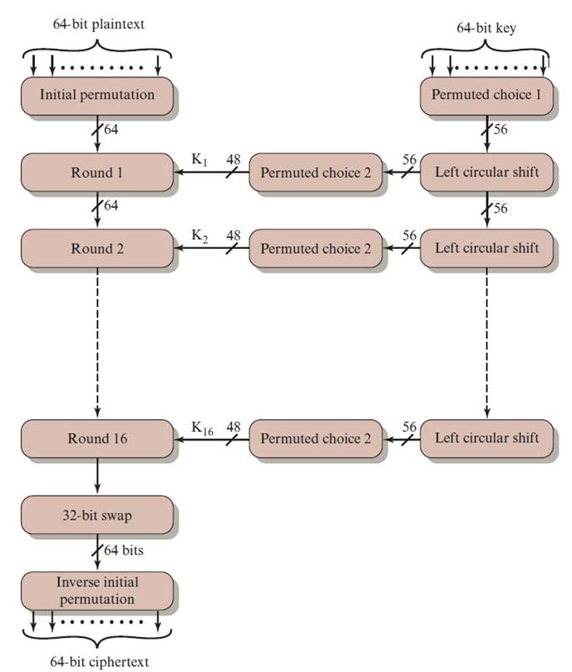
General Depiction of DES Encryption Algorithm
Notes:
The overall scheme for DES encryption is illustrated in Figure 4.5. As with any encryption
scheme, there are two inputs to the encryption function: the plaintext to be
encrypted and the key. In this case, the plaintext must be 64 bits in length and the
key is 56 bits in length.
Looking at the left-hand side of the figure, we can see that the processing
of the plaintext proceeds in three phases. First, the 64-bit plaintext passes through
an initial permutation (IP) that rearranges the bits to produce the permuted input .
This is followed by a phase consisting of sixteen rounds of the same function, which
involves both permutation and substitution functions. The output of the last (sixteenth)
round consists of 64 bits that are a function of the input plaintext and the
key. The left and right halves of the output are swapped to produce the preoutput .
Finally, the preoutput is passed through a permutation [IP ⁻¹ ] that is the inverse of
the initial permutation function, to produce the 64-bit ciphertext. With the exception
of the initial and final permutations, DES has the exact structure of a Feistel
cipher, as shown in Figure 4.3.
The right-hand portion of Figure 4.5 shows the way in which the 56-bit key is
used. Initially, the key is passed through a permutation function. Then, for each of
the sixteen rounds, a subkey (K_{i} ) is produced by the combination of a left circular
shift and a permutation. The permutation function is the same for each round, but a
different subkey is produced because of the repeated shifts of the key bits.
As with any Feistel cipher, decryption uses the same algorithm as encryption,
except that the application of the subkeys is reversed. Additionally, the initial and
final permutations are reversed.

Slide 36
DES Sub-Key Generation
The block size of DES is 64 bits and the encryption key is 56 bits, which is represented as a 64-bit string K = k₁ k₂ … k₆₄
DES uses 16 rounds of iterations with 16 sub-keys
Sub-key generation:
Remove the 8i-th bit (i = 1, 2, …, 8) from K
Perform an initial permutation on the remaining 56 bits of K, denoted by IP_{key}(K)
Split this 56-bit key into two pieces: U₀V₀, both with 28 bits
Perform Left Circular Shift on U₀ and V₀ a defined number of times, producing U_{i}V_{i}:
U_{i} = LS_{z(i)} (U_{i–1}), V_{i} = LS_{z(i)} (V_{i–1})
Permute the resulting U_{i}V_{i} using a defined compress permutation, resulting in a 48-bit string as a sub-key, denoted by K_{i}
K_{i} = P_{key} (U_{i} V_{i} )
https://www.geeksforgeeks.org/data-encryption-standard-des-set-1/

Slide 37
DES Substitution Boxes
The DES substitution function F is defined below:
F(R_{i–1}, K_{i}) = P(S(EP(R_{i–1}) ⊕ K_{i})), i = 1,…,16
First, permute R_{i} using EP(R_{i}) to produce a 48-bit string x
Next, XOR x with the 48-bit sub key K_{i} to produce a 48-bit string y
Function S turns y into a 32-bits string z, using eight 4x16 special matrices, called S-boxes
Each entry in an S-box is a 4-bit string
Break y into 8 blocks, each with 6-bits
Use the i^{th} matrix on the i^{th} block b₁b₂b₃b₄b₅b₆
Let b₁b₆ be the row number, and b₂b₃b₄b₅ the column number, and return the corresponding entry
Each 6-bit block is turned to a 4-bit string, resulting in a 32-bit string z
Finally, permute z using P to produce the result of DES’s F function
This result, XOR’d with L_{i–1}, is R_{i}
https://en.wikipedia.org/wiki/DES_supplementary_material

Slide 38
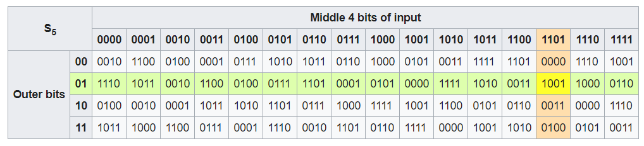
DES Substitution Boxes
Input: “011011”
Output: “1001”

Slide 39
DES encryption steps
Rewrite IP(M) = L₀R₀, where |L₀| = |R₀| =32
For i = 1, 2, …, 16, execute the following operations in order:
L_{i} = R_{i-1}
R_{i} = L_{i-1} ⊕ F(R_{i-1}, K_{i})
Let C = IP⁻¹(R₁₆L₁₆).

Slide 40
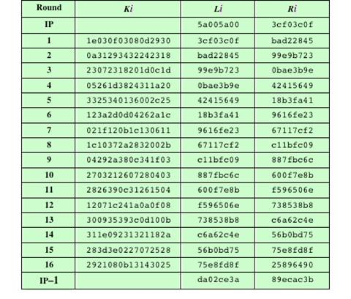
DES Example
Note: DES subkeys are shown as eight 6-bit values in hex format
Notes:
We now work through an example and consider some of its implications. Although
you are not expected to duplicate the example by hand, you will find it informative
to study the hex patterns that occur from one step to the next.
For this example, the plaintext is a hexadecimal palindrome. The plaintext,
key, and resulting ciphertext are as follows:
Plaintext: 02468aceeca86420
Key: 0f1571c947d9e859
Ciphertext: da02ce3a89ecac3b
Table 4.2 shows the progression of the algorithm. The first row shows the 32-bit
values of the left and right halves of data after the initial permutation. The next 16
rows show the results after each round. Also shown is the value of the 48-bit subkey
generated for each round. Note that L_{i} = R_{i-1} . The final row shows the left- and
right-hand values after the inverse initial permutation. These two values combined
form the ciphertext.

Slide 41
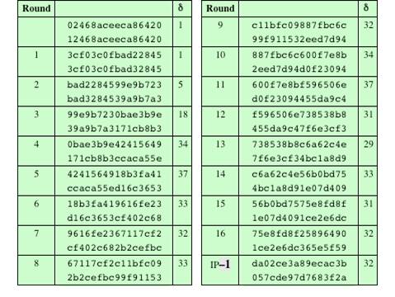
Avalanche Effect in DES: Change in Plaintext
Notes:
A desirable property of any encryption algorithm is that a small change in either
the plaintext or the key should produce a significant change in the ciphertext. In
particular, a change in one bit of the plaintext or one bit of the key should produce
a change in many bits of the ciphertext. This is referred to as the avalanche effect. If
the change were small, this might provide a way to reduce the size of the plaintext
or key space to be searched.
Using the example from Table 4.2, Table 4.3 shows the result when the fourth
bit of the plaintext is changed, so that the plaintext is 12468aceeca86420. The
second column of the table shows the intermediate 64-bit values at the end of each
round for the two plaintexts. The third column shows the number of bits that differ
between the two intermediate values. The table shows that, after just three rounds,
18 bits differ between the two blocks. On completion, the two ciphertexts differ in
32 bit positions.

Slide 42
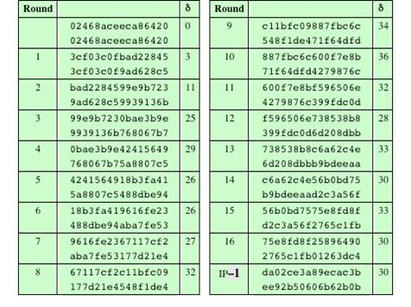
Avalanche Effect in DES: Change in Key
Notes:
Table 4.4 shows a similar test using the original plaintext of with two keys that
differ in only the fourth bit position: the original key, 0f1571c947d9e859, and
the altered key, 1f1571c947d9e859. Again, the results show that about half of
the bits in the ciphertext differ and that the avalanche effect is pronounced after just
a few rounds.

Slide 43
Average Time Required for Exhaustive Key Search
Key Size (bits) | Cipher | Number of Alternative Keys | Time Required at 10⁹ Decryptions/s | Time Required at 10¹³ Decryptions/s
56 | DES | 2⁵⁶ ≈ 7.2 × 10¹⁶ | 2⁵⁵ ns = 1.125 years | 1 hour
128 | AES | 2¹²⁸ ≈ 3.4 × 10³⁸ | 2¹²⁷ ns = 5.3 × 10²¹ years | 5.3 × 10¹⁷ years
168 | Triple DES | 2¹⁶⁸ ≈ 3.7 × 10⁵⁰ | 2¹⁶⁷ ns = 5.8 × 10³³ years | 5.8 × 10²⁹ years
192 | AES | 2¹⁹² ≈ 6.3 × 10⁵⁷ | 2¹⁹¹ ns = 9.8 × 10⁴⁰ years | 9.8 × 10³⁶ years
256 | AES | 2²⁵⁶ ≈ 1.2 × 10⁷⁷ | 2²⁵⁵ ns = 1.8 × 10⁶⁰ years | 1.8 × 10⁵⁶ years
26 characters (permutation) | Monoalphabetic | 2! = 4 × 10²⁶ | 2 × 10²⁶ ns = 6.3 × 10⁹ years | 6.3 × 10⁶ years
Notes:
Since its adoption as a federal standard, there have been lingering concerns about
the level of security provided by DES. These concerns, by and large, fall into two
areas: key size and the nature of the algorithm.
With a key length of 56 bits, there are 2⁵⁶ possible keys, which is approximately
7.2 * 10¹⁶ keys. Thus, on the face of it, a brute-force attack appears impractical.
Assuming that, on average, half the key space has to be searched, a single machine
performing one DES encryption per microsecond would take more than a thousand
years to break the cipher.
However, the assumption of one encryption per microsecond is overly conservative.
As far back as 1977, Diffie and Hellman postulated that the technology
existed to build a parallel machine with 1 million encryption devices, each of which
could perform one encryption per microsecond [DIFF77]. This would bring the
average search time down to about 10 hours. The authors estimated that the cost
would be about $20 million in 1977 dollars.
With current technology, it is not even necessary to use special, purpose-built
hardware. Rather, the speed of commercial, off-the-shelf processors threaten the
security of DES. A recent paper from Seagate Technology [SEAG08] suggests that
a rate of 1 billion (10⁹ ) key combinations per second is reasonable for today’s multicore
computers. Recent offerings confirm this. Both Intel and AMD now offer
hardware-based instructions to accelerate the use of AES. Tests run on a contemporary
multicore Intel machine resulted in an encryption rate of about half a billion
encryptions per second [BASU12]. Another recent analysis suggests that with
contemporary supercomputer technology, a rate of 10¹³ encryptions per second is
reasonable [AROR12].
With these results in mind, Table 4.5 shows how much time is required for
a brute-force attack for various key sizes. As can be seen, a single PC can break
DES in about a year; if multiple PCs work in parallel, the time is drastically shortened.
And today’s supercomputers should be able to find a key in about an hour.
Key sizes of 128 bits or greater are effectively unbreakable using simply a brute-force
approach. Even if we managed to speed up the attacking system by a factor
of 1 trillion (10¹² ), it would still take over 100,000 years to break a code using a
128-bit key.
Fortunately, there are a number of alternatives to DES, the most important of
which are AES and triple DES, discussed in Chapters 6 and 7, respectively.

Slide 44
Is DES good enough?
Security strength of DES
Number of rounds
Length of encryption key
Construction of the substitute function
DES was used up to the 1990’s.
People began to take on the DES Challenges to crack DES
Only uses 56-bit keys = 2⁵⁶ ~ 7.2× 10¹⁶ keys
Brute-force will work with current technology
In 1997 on Internet in a few months
In 1998 on dedicated h/w (EFF) in a few days
In 1999 above combined in 22 hours

Slide 45
What to Do Next?
Start over
New standards begin to be looked into
On the other hand, can we extend the use of DES?
Notes:
Start over =Start again

Slide 46
Block Cipher Design Principles: Number of Rounds
The greater the number of rounds, the more difficult it is to perform cryptanalysis
In general, the criterion should be that the number of rounds is chosen so that known cryptanalytic efforts require greater effort than a simple brute-force key search attack
If DES had 15 or fewer rounds, differential cryptanalysis would require less effort than a brute-force key search
Notes:
The cryptographic strength of a Feistel cipher derives from three aspects of the
design: the number of rounds, the function F, and the key schedule algorithm. Let
us look first at the choice of the number of rounds.
The greater the number of rounds, the more difficult it is to perform cryptanalysis,
even for a relatively weak F. In general, the criterion should be that the
number of rounds is chosen so that known cryptanalytic efforts require greater
effort than a simple brute-force key search attack. This criterion was certainly used
in the design of DES. Schneier [SCHN96] observes that for 16-round DES, a differential
cryptanalysis attack is slightly less efficient than brute force: The differential
cryptanalysis attack requires 2^{55.1} operations, whereas brute force requires 2⁵⁵ . If
DES had 15 or fewer rounds, differential cryptanalysis would require less effort
than a brute-force key search.
This criterion is attractive, because it makes it easy to judge the strength of
an algorithm and to compare different algorithms. In the absence of a cryptanalytic
breakthrough, the strength of any algorithm that satisfies the criterion can be
judged solely on key length.

Slide 47
Block Cipher Design Principles: Design of Function F
The heart of a Feistel block cipher is the function F
The more nonlinear F, the more difficult any type of cryptanalysis will be
The SAC and BIC criteria appear to strengthen the effectiveness of the confusion function
The algorithm should have good avalanche properties
Strict avalanche criterion (SAC)
States that any output bit j of an S-box should change with probability 1/2 when any single input bit i is inverted for all i , j
Bit independence criterion (BIC)
States that output bits j and k should change independently when any single input bit i is inverted for all i , j , and k
Notes:
The heart of a Feistel block cipher is the function F, which provides the element
of confusion in a Feistel cipher. Thus, it must be difficult to “unscramble” the
substitution performed by F. One obvious criterion is that F be nonlinear, as we
discussed previously. The more nonlinear F, the more difficult any type of cryptanalysis
will be. There are several measures of nonlinearity, which are beyond
the scope of this book. In rough terms, the more difficult it is to approximate F
by a set of linear equations, the more nonlinear F is.
Several other criteria should be considered in designing F. We would like the
algorithm to have good avalanche properties. Recall that, in general, this means that
a change in one bit of the input should produce a change in many bits of the output.
A more stringent version of this is the strict avalanche criterion (SAC) [WEBS86],
which states that any output bit j of an S-box (see Appendix C for a discussion of
S-boxes) should change with probability 1/2 when any single input bit i is inverted
for all i , j . Although SAC is expressed in terms of S-boxes, a similar criterion could
be applied to F as a whole. This is important when considering designs that do not
include S-boxes.
Another criterion proposed in [WEBS86] is the bit independence criterion
(BIC), which states that output bits j and k should change independently when any
single input bit i is inverted for all i , j , and k . The SAC and BIC criteria appear to
strengthen the effectiveness of the confusion function.

Slide 48
Block Cipher Design Principles: Key Schedule Algorithm
With any Feistel block cipher, the key is used to generate one subkey for each round
In general, we would like to select subkeys to maximize the difficulty of deducing individual subkeys and the difficulty of working back to the main key
It is suggested that, at a minimum, the key schedule should guarantee key/ciphertext Strict Avalanche Criterion and Bit Independence Criterion
Notes:
With any Feistel block cipher, the key is used to generate one subkey for each
round. In general, we would like to select subkeys to maximize the difficulty of
deducing individual subkeys and the difficulty of working back to the main key. No
general principles for this have yet been promulgated.
Adams suggests [ADAM94] that, at minimum, the key schedule should
guarantee key/ciphertext Strict Avalanche Criterion and Bit Independence
Criterion.

